Slide 1

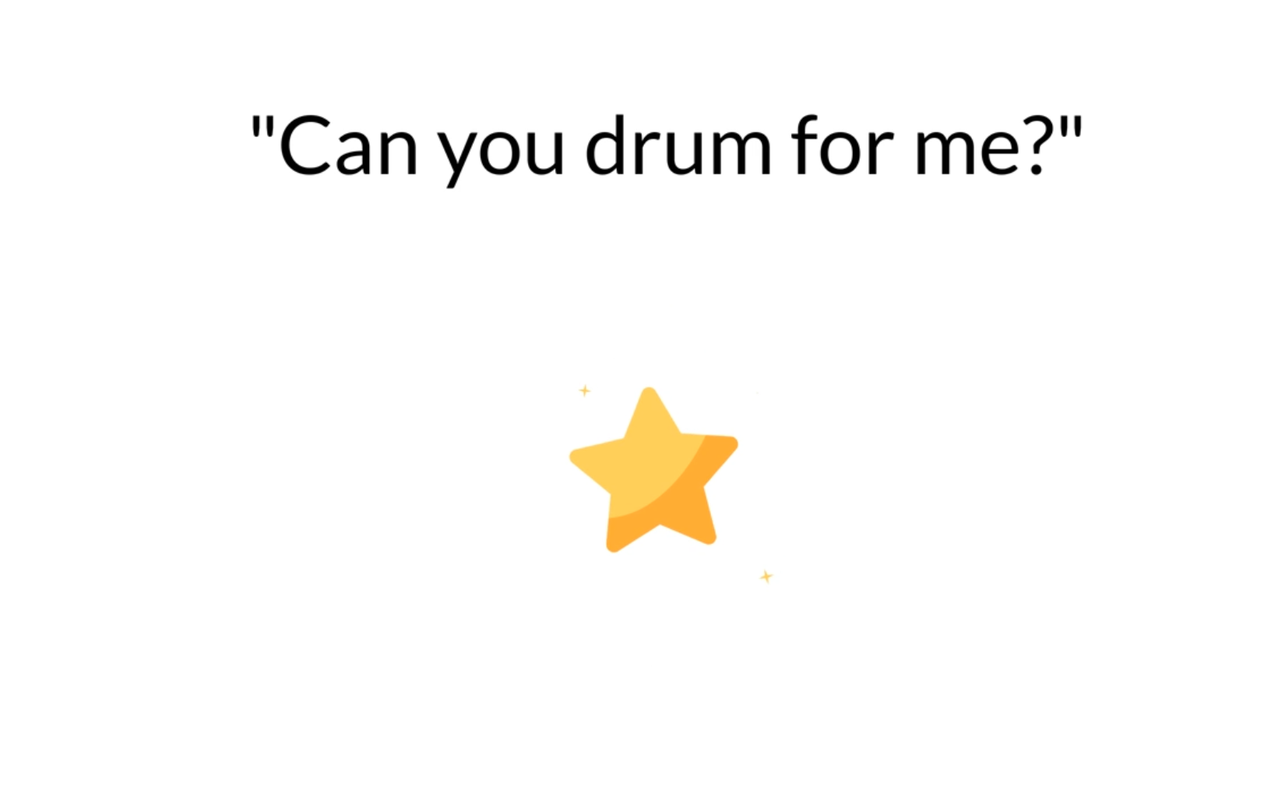
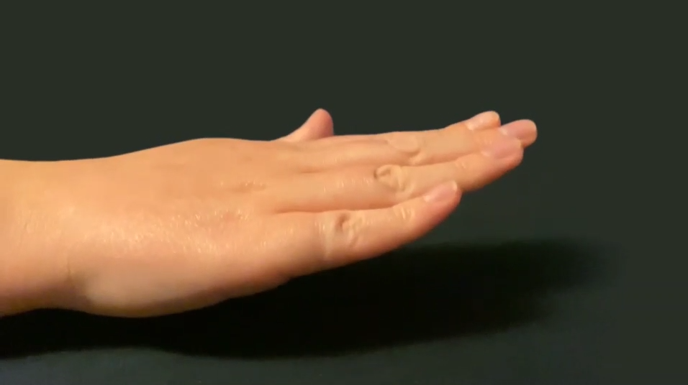

Spontaneous
motor tempo 1
4 x
Drumming
demo trials
Spontaneous
motor tempo 2
Tempos
400, 500, 600 or 700ms
30 seconds
4 x 20 seconds
30 seconds
Tempo order 1: 400 -> 600 -> 500 -> 700
Tempo order 2: 700 -> 500 -> 600 -> 400

Slide 2
